Slide 1
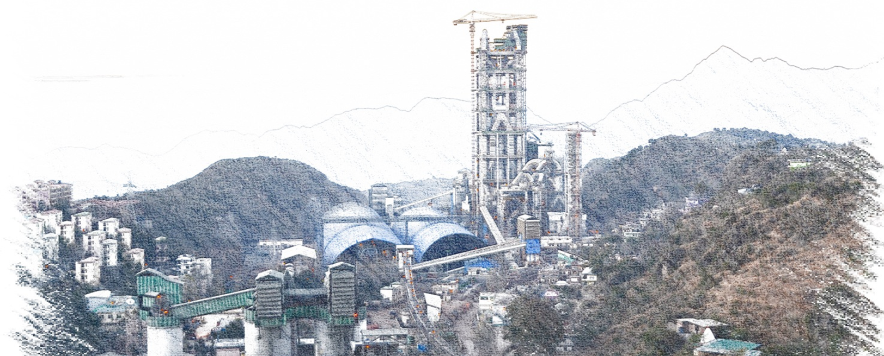
Maintenance Budget and Forecasting
Concept and recommendations
© 2014 Holcim Techology Ltd

Slide 2





What is a budget?
A budget is a financial plan that lists all probable expenses and income for a given period, usually a fiscal year. It is a forecast of expenses, revenue and profit.
Source: http://www.bocomobar.org
What we intend to achieve?
What we are going to do and how much will cost?
What we should get from?

Slide 3
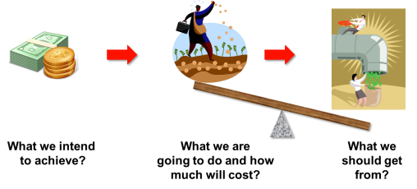

Why would we want one?
Who wants to run out of money?!?
It’s all about control!
It will help to prioritize the spending, grow company income and avoid unpleasant surprises
Maintenance budget

Slide 4
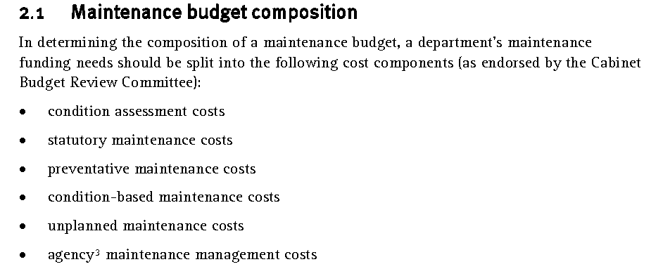

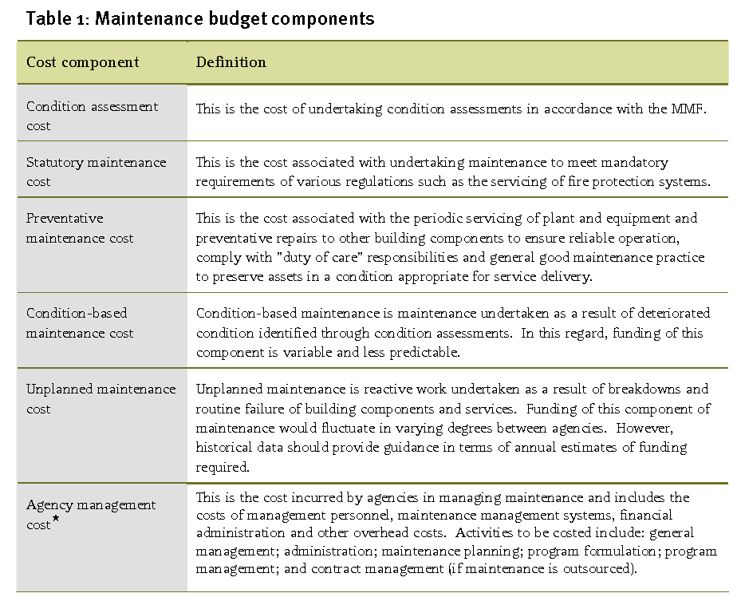
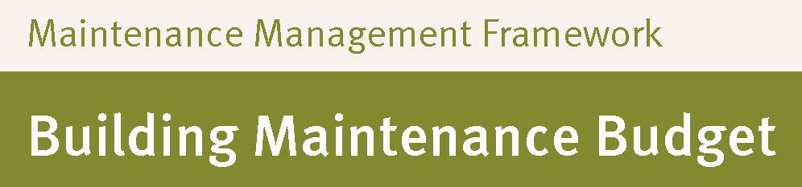
A “Zero based maintenance budgeting” is requested as start

Slide 5
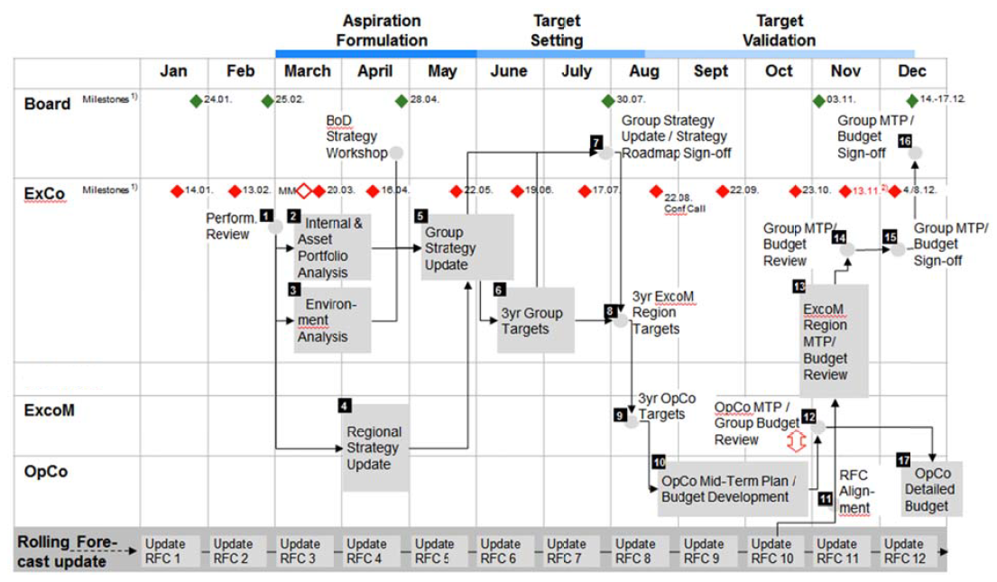
Maintenance budgeting is part of Lafarge Holcim business cycle

Slide 6
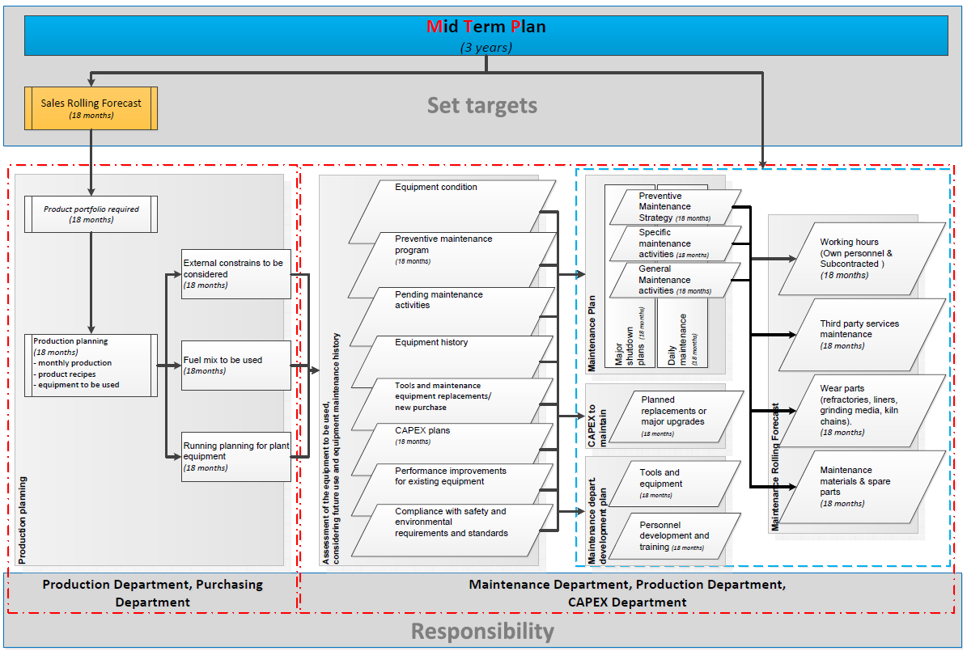



Development of a Maintenance budgeting is a complex process involving detailed information to be processed
15A

Slide 7
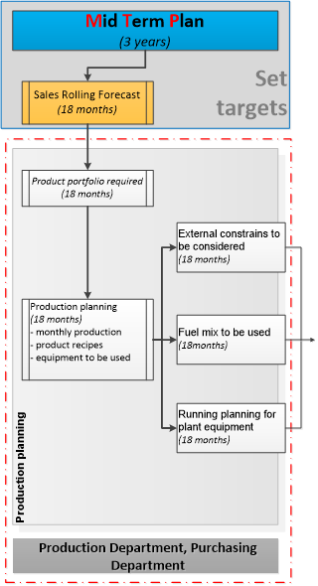
The set company objectives are to be transposed in products and operational needs
Sales budget
Quantities per product types
Deliveries schedule by months
Product portfolio required
Establishing the products recipes
Production planning with setup the
Monthly production required
Products recipes to be used
Equipment to be used (including power generation)
Notes:
Based on production planning is developed the working program per departments, per plant equipment considering:
Year start stocks for raw materials, additives, clinker, cement stocks, fuels, AFR and MIC
Required quantities of raw materials, additives, fuels, AFR and MIC to be handled during all year, with deliveries schedule
Foreseen pick times sales and production
Foreseen production capacity - increase or decrease
Foreseen process changes
Foreseen changes of raw materials, correctives, additives and mineral components
Possible changes of the equipment behavior due to the fuel mix change (thermal load, wearing rate, corrosion) must be counted as budget input information
Constrains which can bring limitations and minimum requirements for working schedule for plant equipment must be considered for production planning. As examples but not limited to, we have:
Power supply contract conditions
Emissions limits and monitoring requirements
CO2 allowances
Environment constrains, other than gas emissions
…

Slide 8
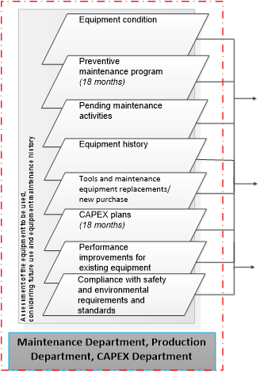
All components of maintenance program must contribute on collecting the right info to build a reliable budget
Zero based Budgeting concept will require full analysis of the needs
Data collection from different sources regarding equipment condition, preventive and corrective maintenance needs, equipment history, plant development, safety and environmental conditions and needs

Slide 9
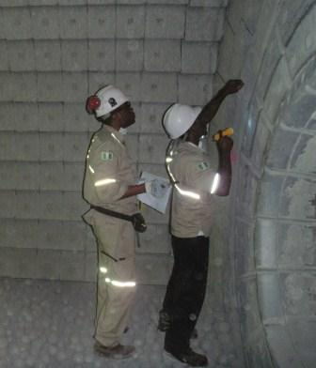
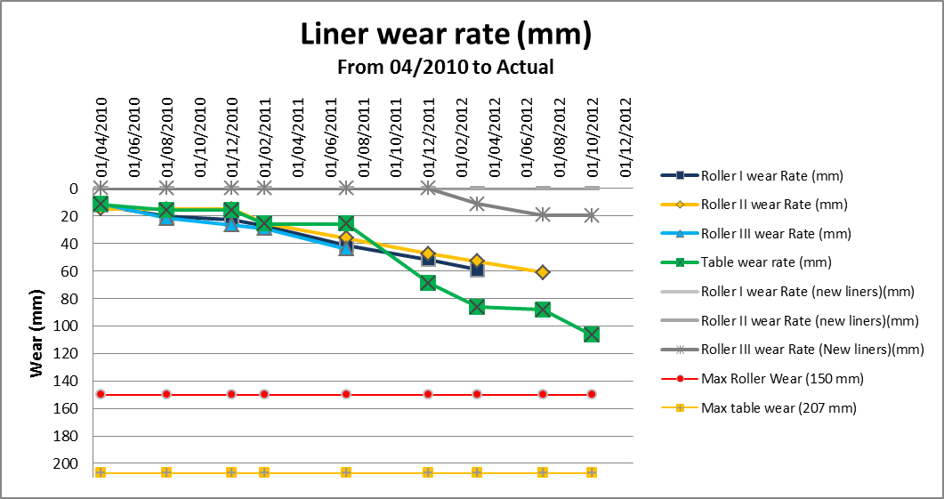
As deep is the knowledge about equipment condition as accurate will maintenance needs estimation
All potential source of information must be considered
PMR’s results
Condition monitoring results
walk by inspections
vibration measurements,
non-destructive testing,
thermography measurements,
oil analysis,
wear measurements
Evaluations during repairs and reconditioning

Slide 10
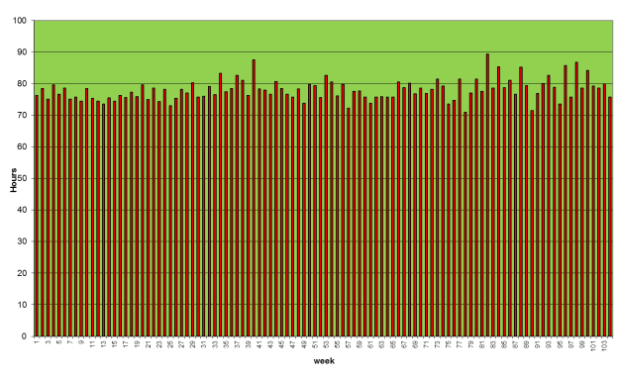
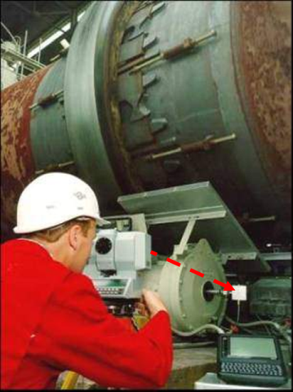
Equipment type, utilization degree planned and criticality will be input to establish preventive maintenance program
Equipment utilization and annual maintenance schedule will influence the preventive maintenance activities
Resources required must be estimated:
Manpower own and subcontracted
3rd party services
Spares and materials
Equipment to be commissioned during the budget year must be part of the needs analysis
Workload balance

Slide 11
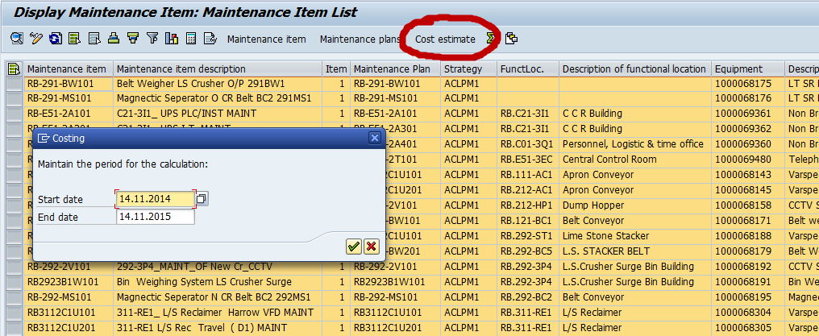
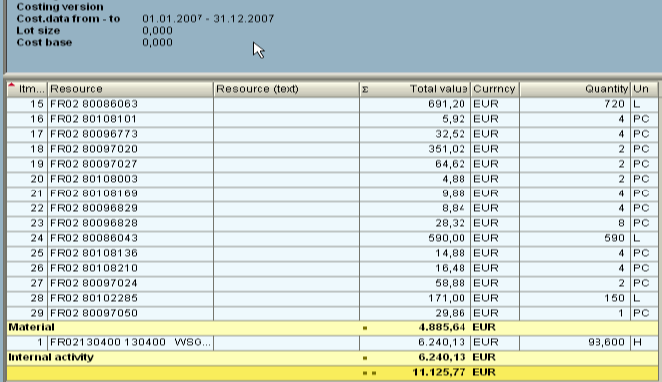
Cost estimations can be done based on already existing data
Preventive Maintenance cost estimation though exiting maintenance plans in SAP (IP18)
Select all plans for
your Plant, date range,
and select cost estimate

Slide 12
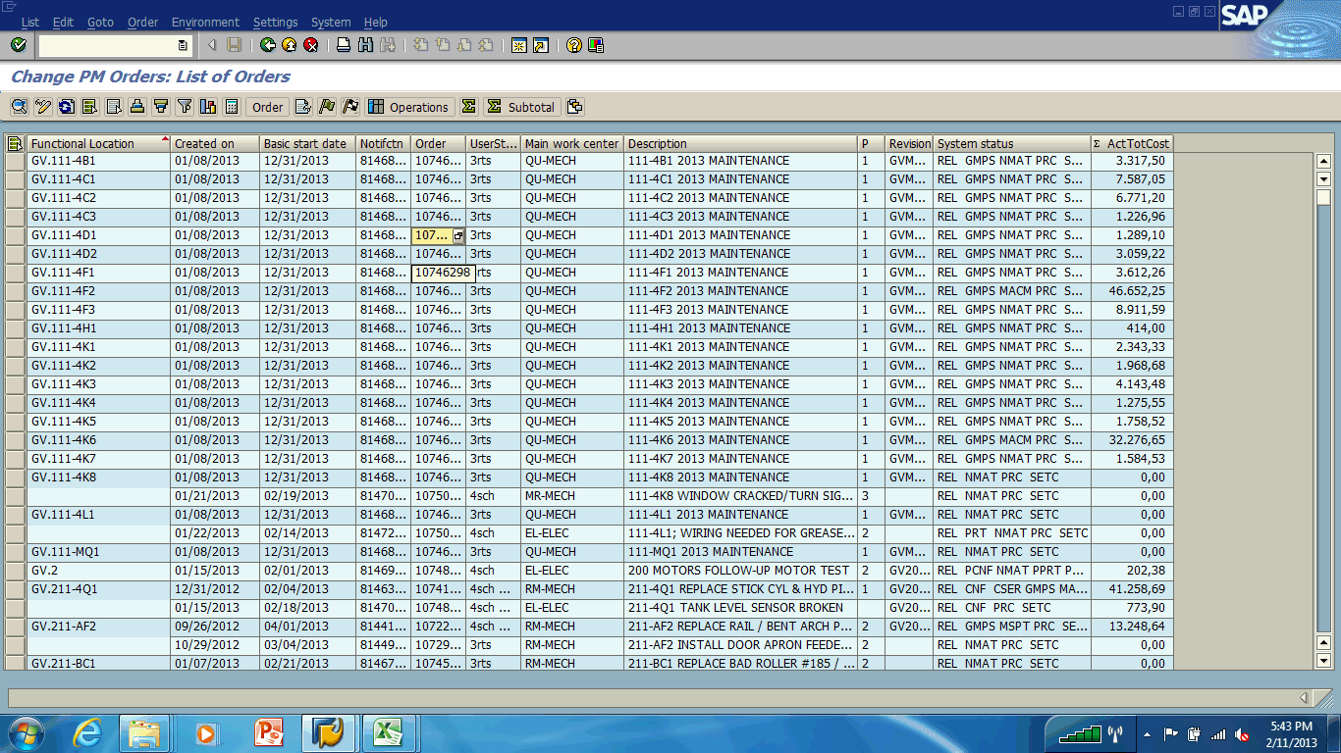
Outstanding maintenance activities brings in already a list of activities to be performed

Slide 13
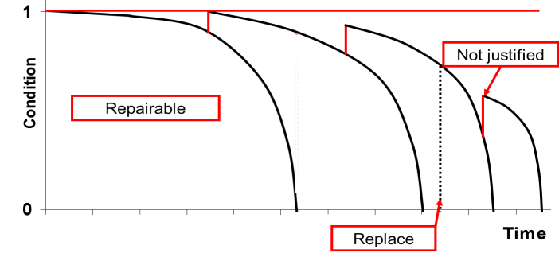
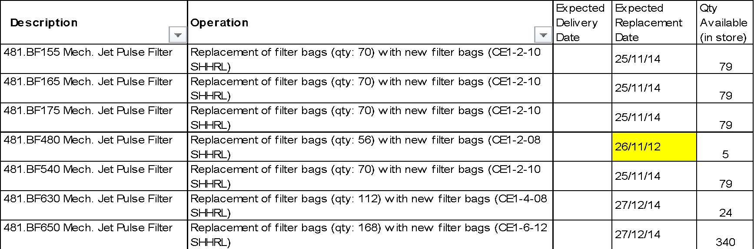
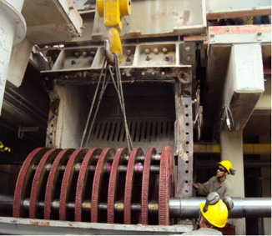
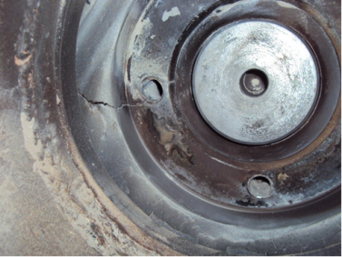
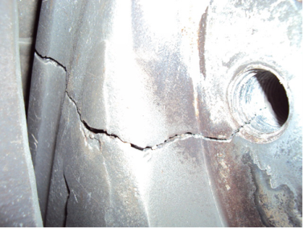
We can build our future by using history: Which works were necessary?
Equipment replacement strategy
Electric motors
Reducers
Pumps, etc..
Time based replacement of spares
Filter bags
Air slide canvas
Hydraulic hoses
Filters
Known equipment issues not yet under control / solved
Notes:
When do we need to replace an equipment?
Technical obsolescence
High maintenance costs (repair/overhaul), especially compared against cost of replacement
Possibility of energy savings (operation cost)
Increase in Production capacity
Flexibility for different product types
Regulatory requirements
Avoid: ‚Equipment works, but it is old‘ or ‚We need to stay updated with state of the art equipment‘
But, what does this actually mean?
We do not want to replace the equipment too late, since the repairs would be more costly, besides lost production/efficiency
An early replacement means more cost, since we are ‘throwing away’ part of the equipment life
CAPEX constraints play a major role in prioritizing and looking for other alternatives (contingency plans)
Where do we start?
KPI/data analysis
Equipment with the highest maintenance cost
Equipment with the highest number of Notifications/Work Orders (Equipment history)
Contributor to low Net Availability/Low MTBF
Increasing MTTR
Increased power consumption
Non compliance with legal regulations (safety, environment)
Do not forget to take into account the repair costs vs the replacement cost
Acceptable level has to be defined by Group Company (part of Risk Matrix, e.g. 60% of value of asset)
The Pareto analysis is crucial to detect the ‚troublesome equipment‘ that might need a replacement
This is however, rather reactive part of the analysis (need to wait until the symptoms are there)

Slide 14
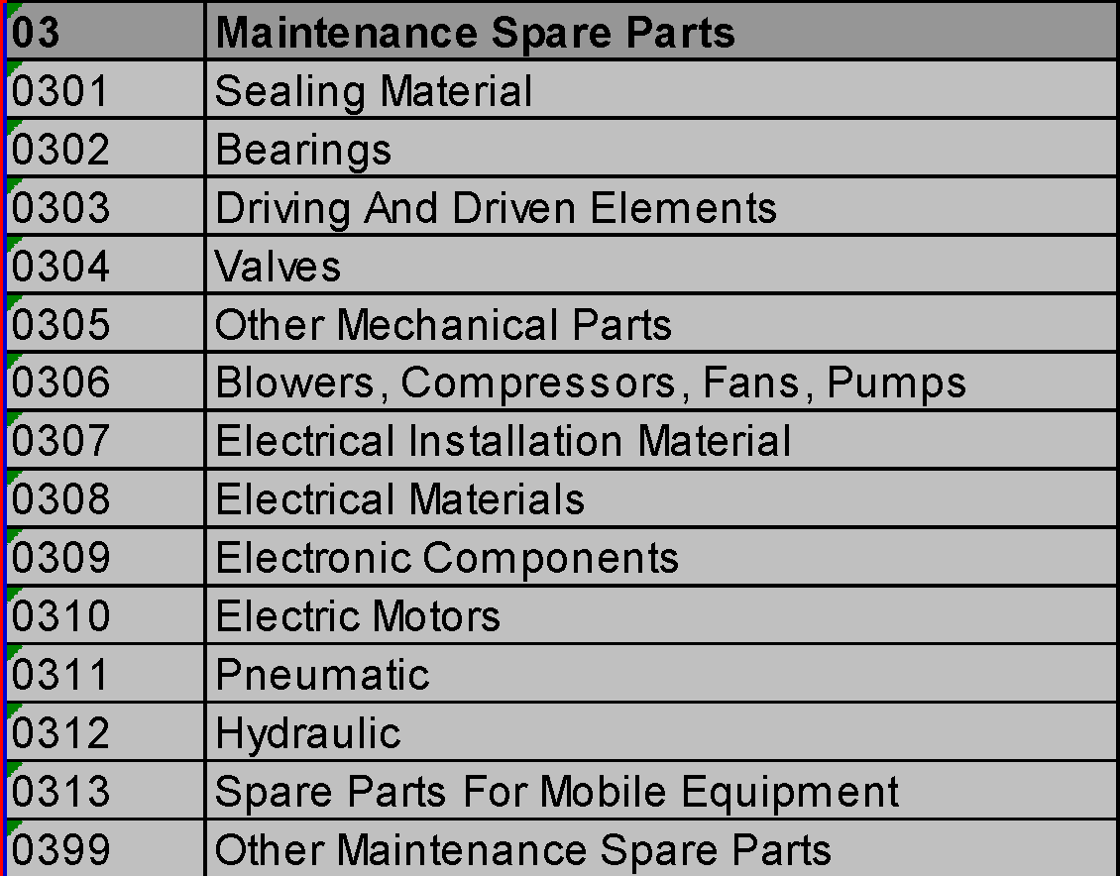
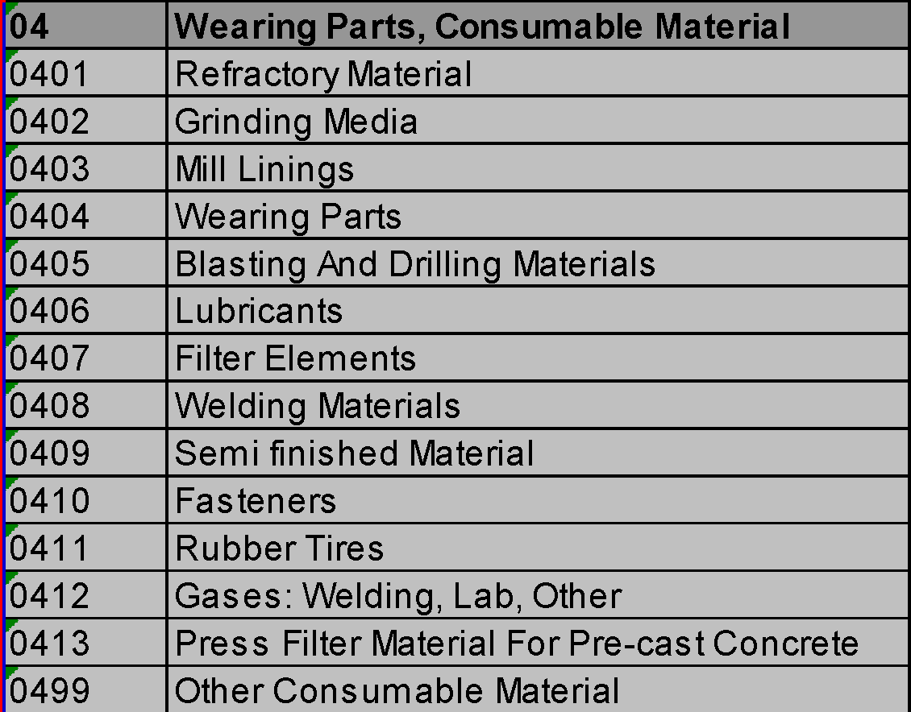
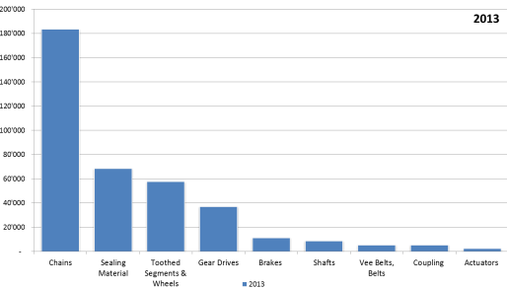
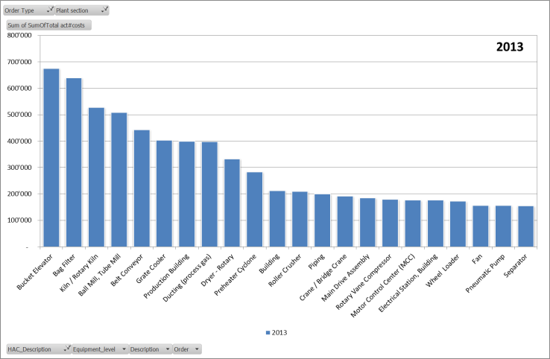
We can build our future by using history: What we need and how much it cost?
Recurrent maintenance materials
Idlers replacement
Gaskets & seals
Gases and welding
Electric materials
etc.
Recurrent maintenance services
Fabrication
Machining
Welding
etc.
PCS code – material consumption analysis
Equipment cost analysis

Slide 15
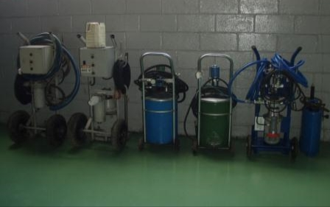
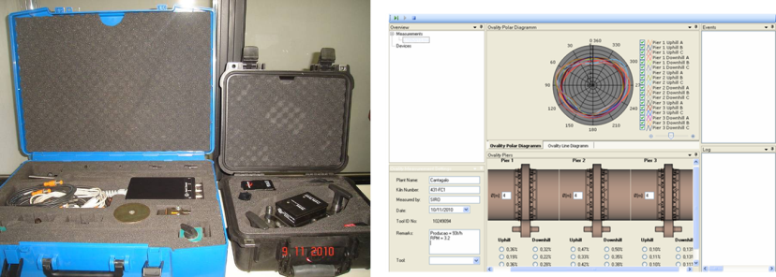
Time is passing machine get obsolete, new techniques are developed for maintenance. We need to be prepared!
Replacement and new purchase
Tools
Welding and oxy-cut machines
etc.
Introduction of new preventive maintenance practices and condition monitoring
Grease guns
Vibro-pen
Ultra-probe
Oil sampling and testing
etc.

Slide 16
Plants are evolving - Old equipment need to be replaced, new types of equipment get in. We need to be prepared!
Ongoing CAPEX must be considered due to their influence in future maintenance needs
Additional preventive maintenance program to be implemented
Estimated resources and services might be required
Additional effort might be required to maintain some equipment due to expected effects due to changes in operating conditions
Mechanical and thermal load
Corrosion
Etc.

Slide 17
Equipment improvements are necessary and must be kept in the maintenance activities to be performed
Safety
Simplifying Repairs
Identification / marking
Simplifying Inspections
Maintainability
Technical documentation
Simplifying housekeeping
Inter changeability
Ease of operation
Standardization

Slide 18
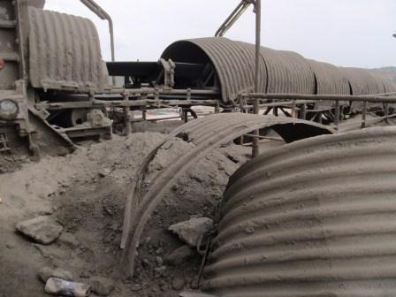
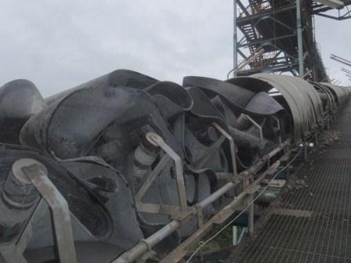
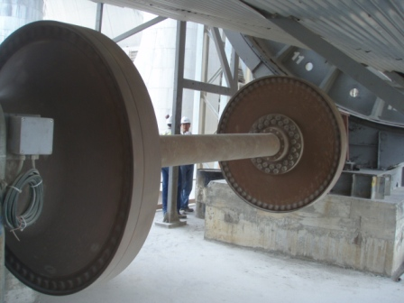
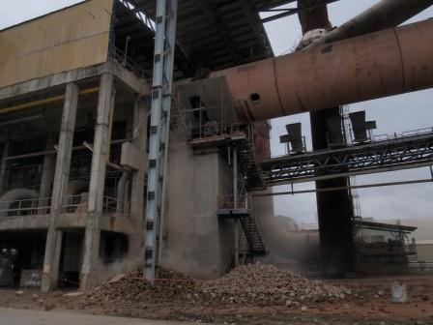
Where we are, where we would like to go!?
Technical assessments
RCFA outcome
Environmental requirements and standards
Safety compliance

Slide 19
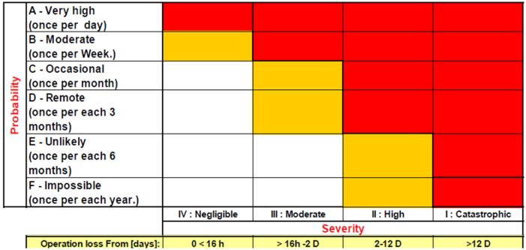
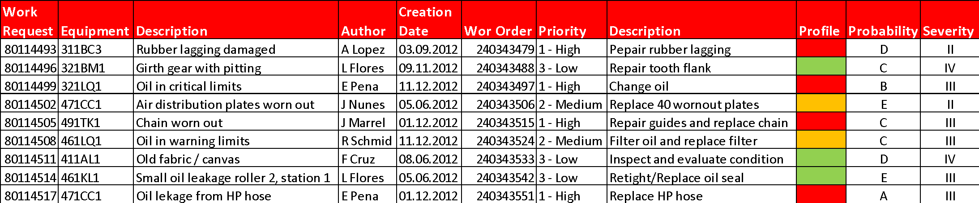
Resources are limited – risks analysis should be included to decide the activities to be budgeted
When spending restrictions, performing risk analysis helps to determine the impact-consequence in case of failure
What could happen if…?

Slide 20

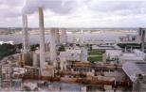
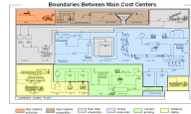

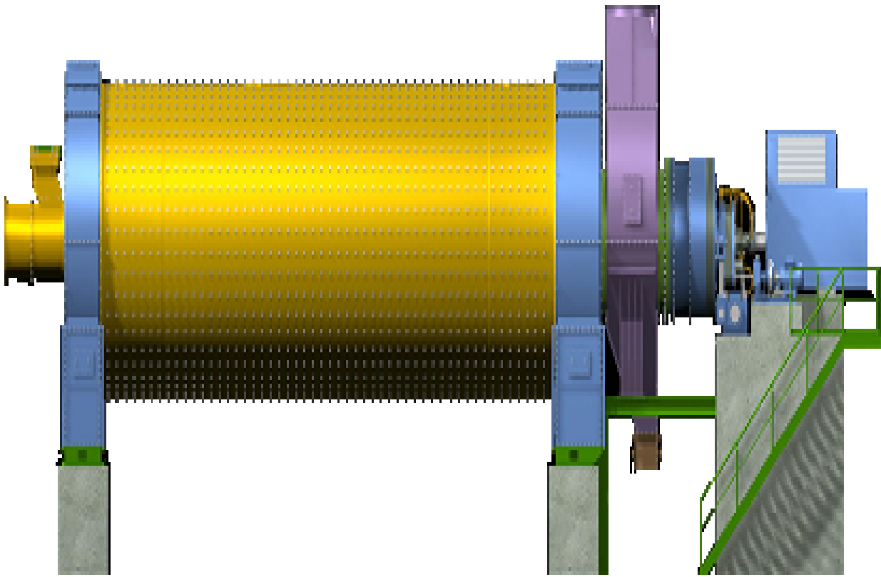

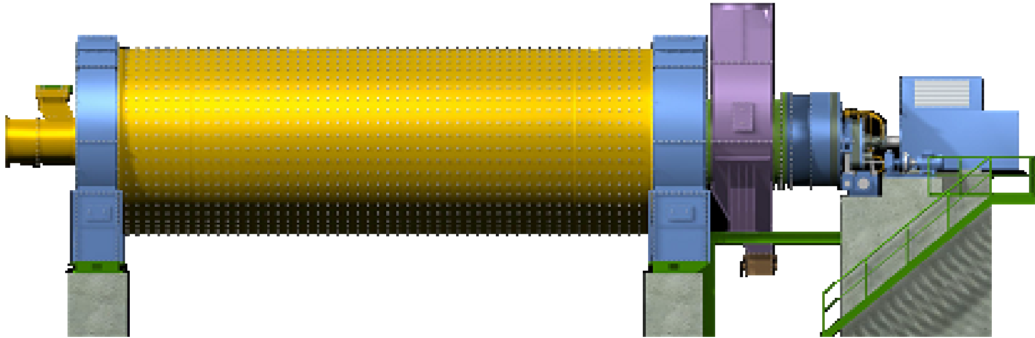
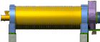

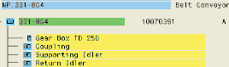
Level of details will depend on cost level and activity type
Controlling Area : EE00
Planning Plant: NP
Plant Section: 03
Location: Raw mill Line 1
Functional Location: Ball mill
Equipment: Ball mill
Equipment: Ball mill drive
Assembly

Slide 21
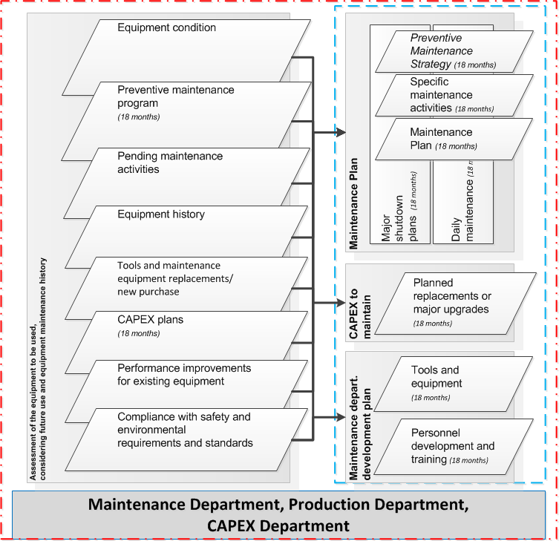
The list of maintenance activity is the budget maintenance basis
Maintenance Plan
Major shutdown plans
Daily maintenance
CAPEX to maintain
Planned replacement or major upgrades qualifying for and approved as CAPEX
Maintenance department development plan
Tools and equipment
Personnel development and training

Slide 22
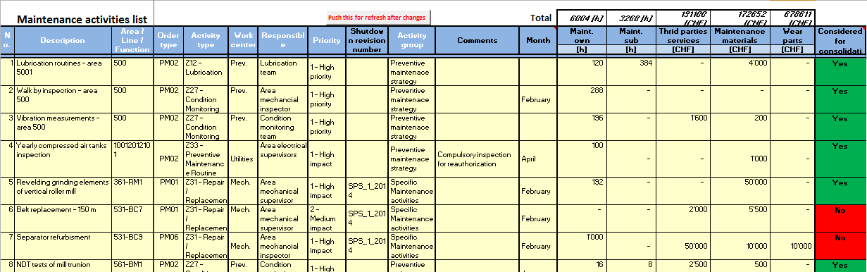
Activity list will contain estimations per cost elements
Working hours for own and subcontracted personnel
Third party services maintenance
Wear parts – refractories, liners, grinding media, kiln chains, etc.
Materials and spare parts

Slide 23
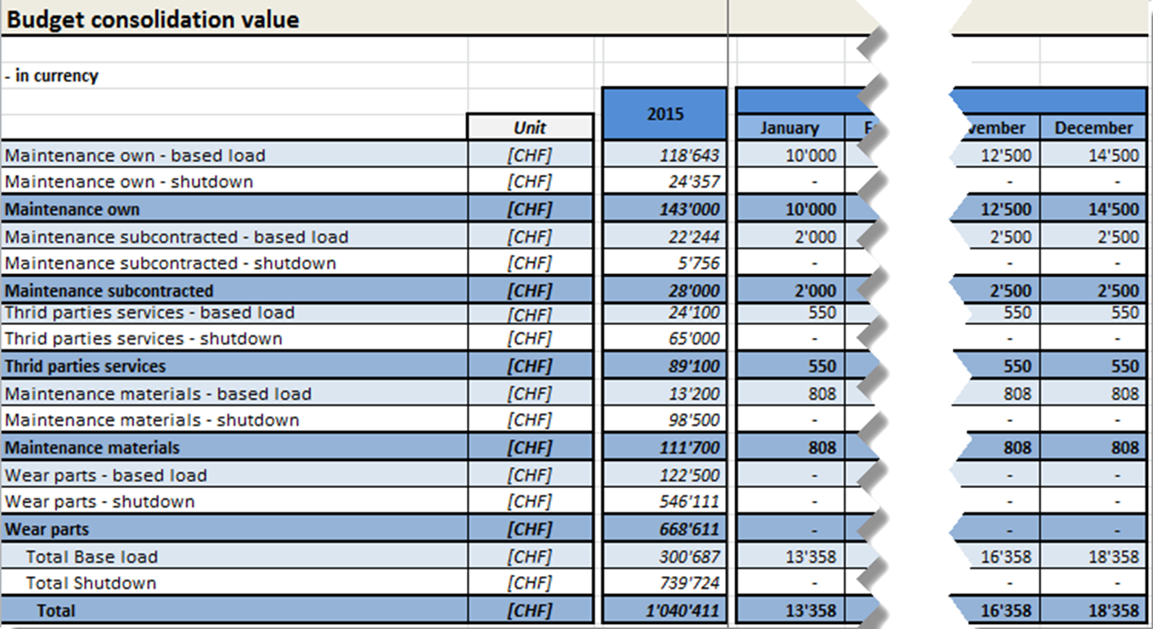
Maintenance budget it is the consolidation of the estimated costs by each cost element

Slide 24
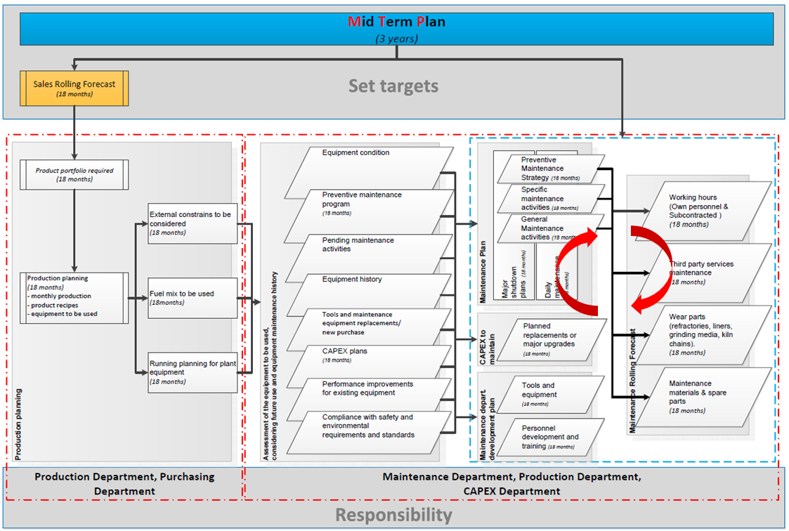
Budget value is to be validated against Mid Term Plan targets
Cost level challenging is to be done on activities, their priority and results of the risk analysis to assure equipment desired reliability
Targets to be considered
Group level indicators
EBIDTA
ROIC
Maintenance reference value

Slide 25
Forecasting is a live budgeting
The list of maintenance activities is to be updated
current costs for activities performed
additional activities performed out of the initial budget
rescheduled activities from the prior months
cancelled activities from prior month and from further planned list
additional activities to be performed in the future months

Slide 26
Early information about needs better prices for purchase
When we involve procurement?
Potential suppliers are defined? Are they available? What about prices?
What spare parts will be necessary? Do you have them on stock? When do you need them? What is the lead time?

Slide 27
Hard job and complicated?
Yes but once it is in place year to year the process becomes easier
Right decision requires accurate data
Preventive maintenance programs must be accurate and well in place
Maintenance planning and schedule must be up to date and efficient
Accurate data recorded in work orders is essential to analyze your maintenance cost
Identifying cost drivers can highlight opportunities to improve deficiencies

Slide 28
Budgeting and forecasting are essential to assure company performance
An adequate budget process leads to:
Better planning and prioritization of the maintenance activities and expenses with high transparency
Increase the knowledge of the plant equipment condition and potential risks
Better understanding of the maintenance cost drivers and identify opportunities to improve the maintenance program
Better cost control by identifying the deviations and hence right prioritization
The budget shouldn’t be:
The maintenance cost of last year, proportional adjusted to the production volume of the next year, or
The maintenance cost at last year reduced by a percentage

